Slide 1
Reinforcement Learning
Learning an Actor
Learning an Critic
Actor-Critic

Slide 2
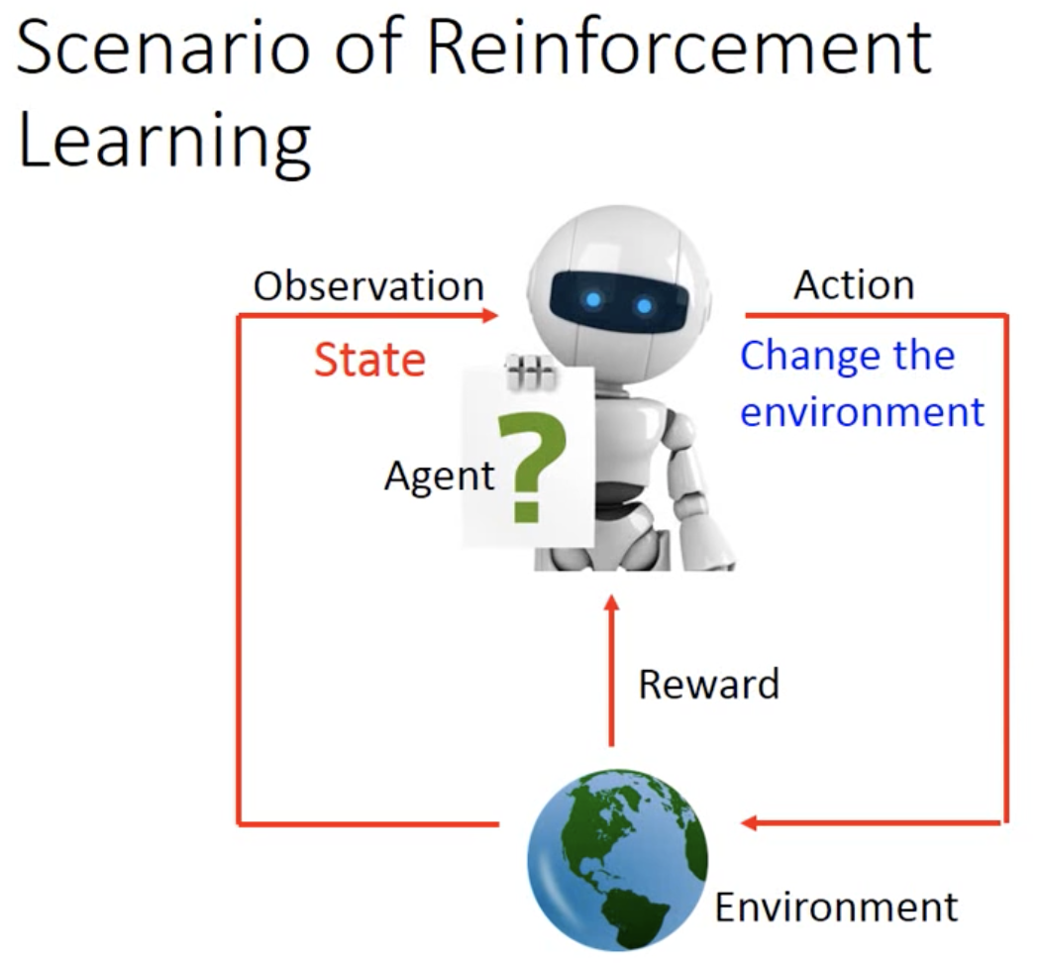
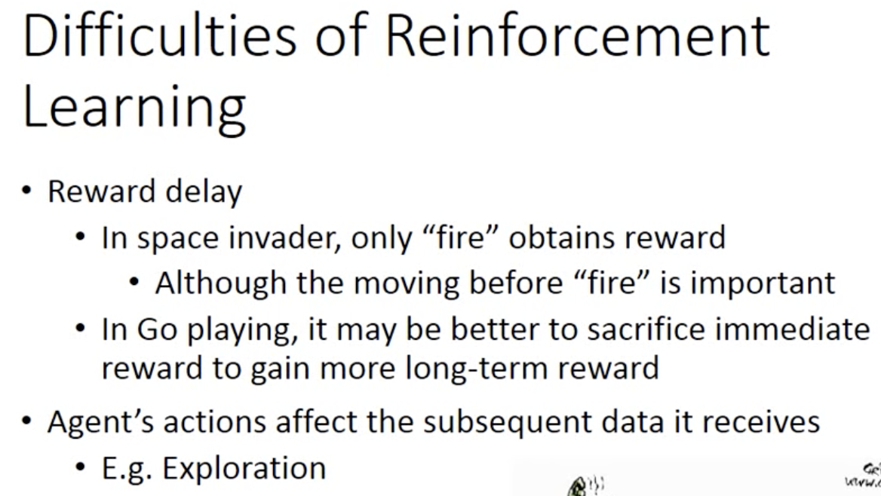

Slide 3
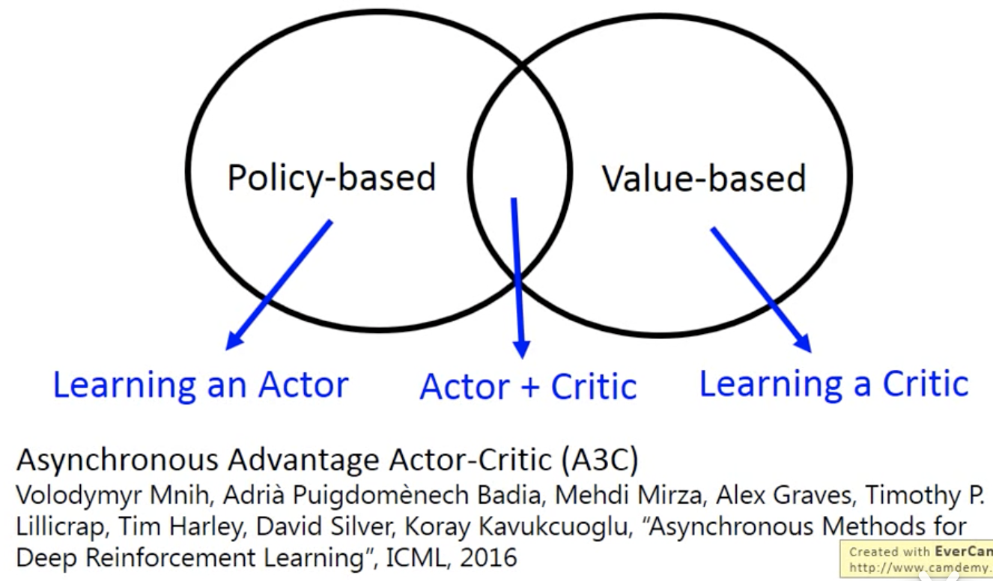
Model free

Slide 4
Learning an Actor——Policy Gradient

Slide 5
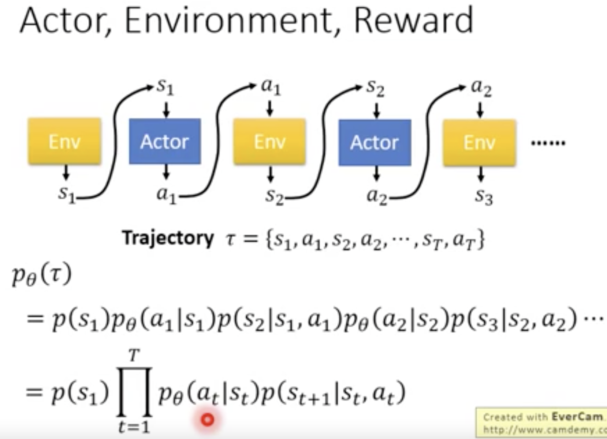
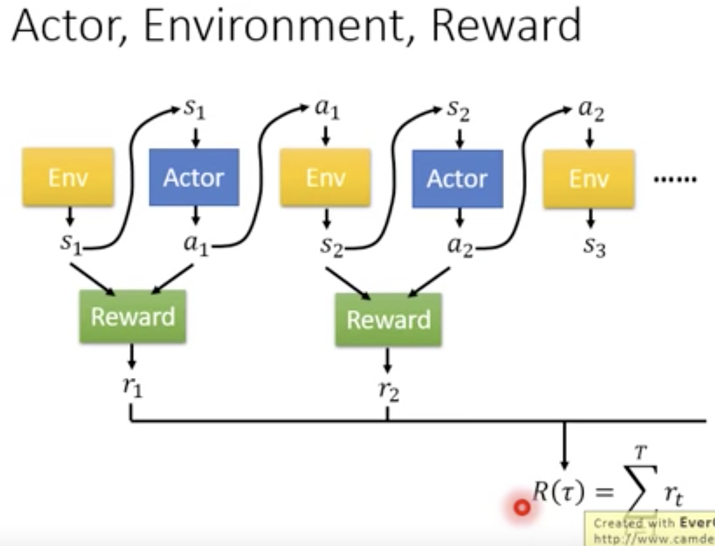
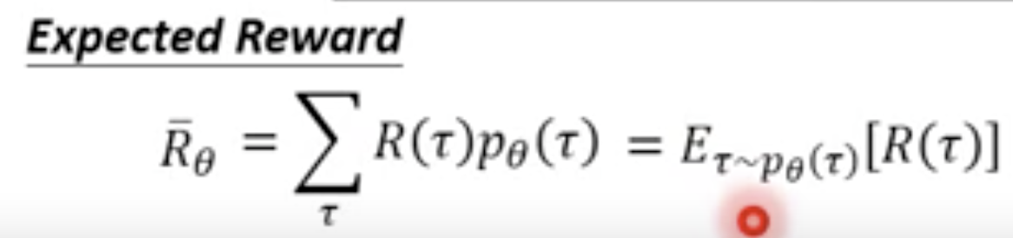
Policy Gradient

Slide 6
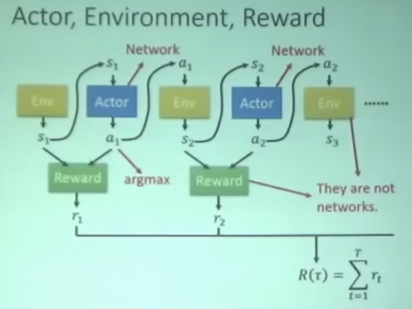
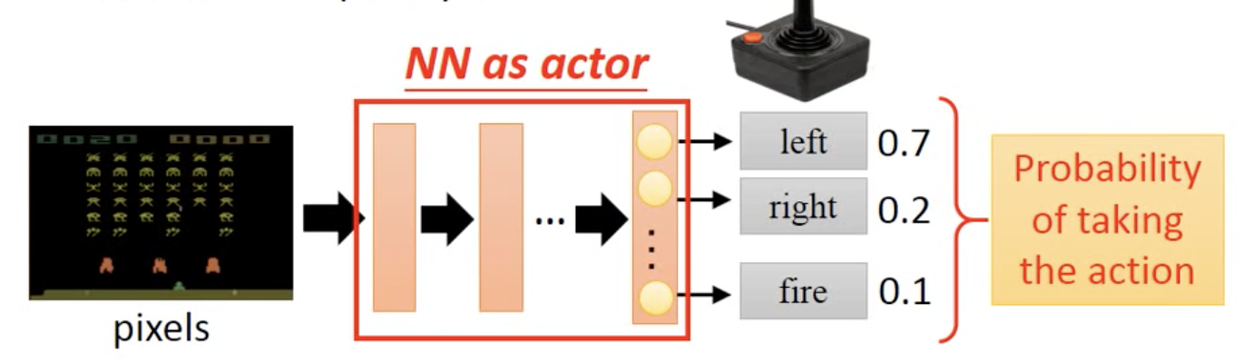
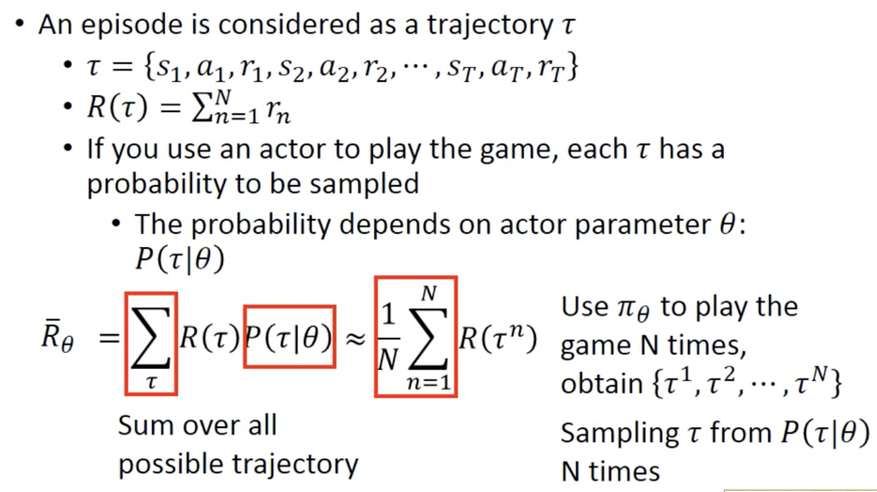
Policy Gradient
Step1：Neural Network
as Actor
Step2：Goodness of Actor
大数定理

Slide 7
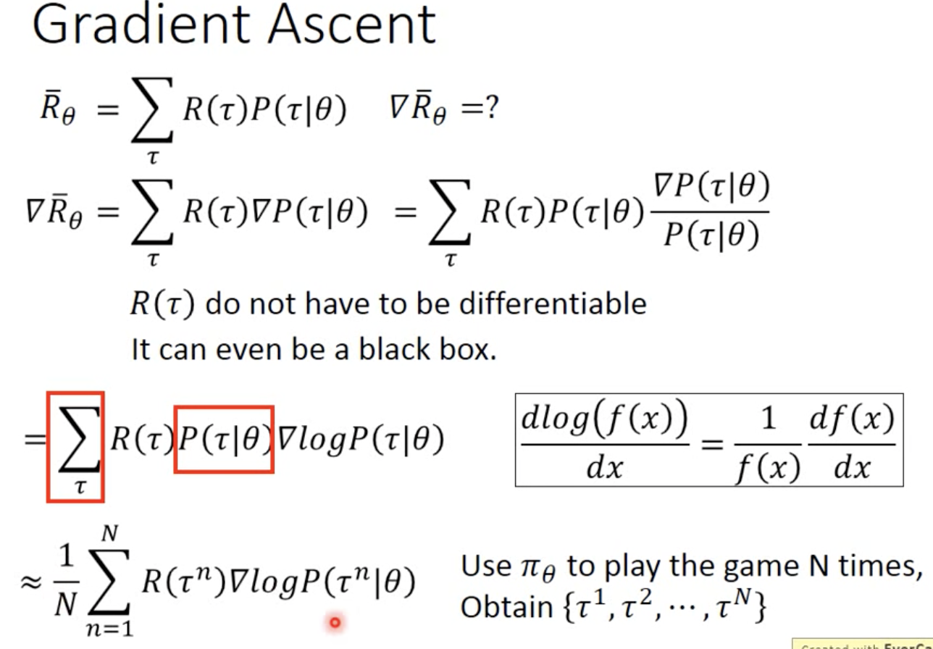
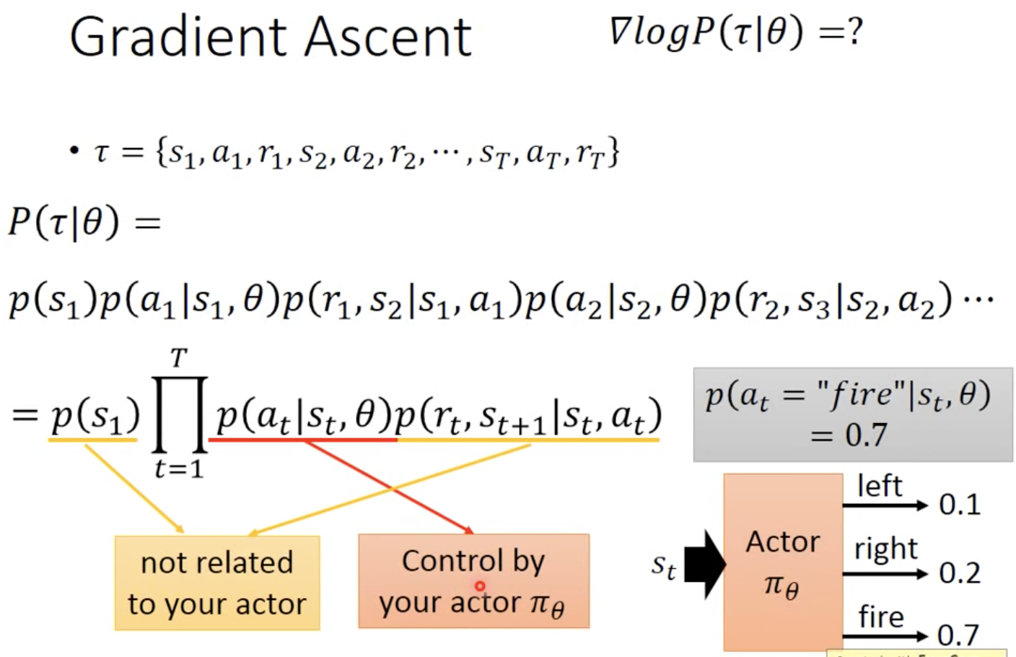
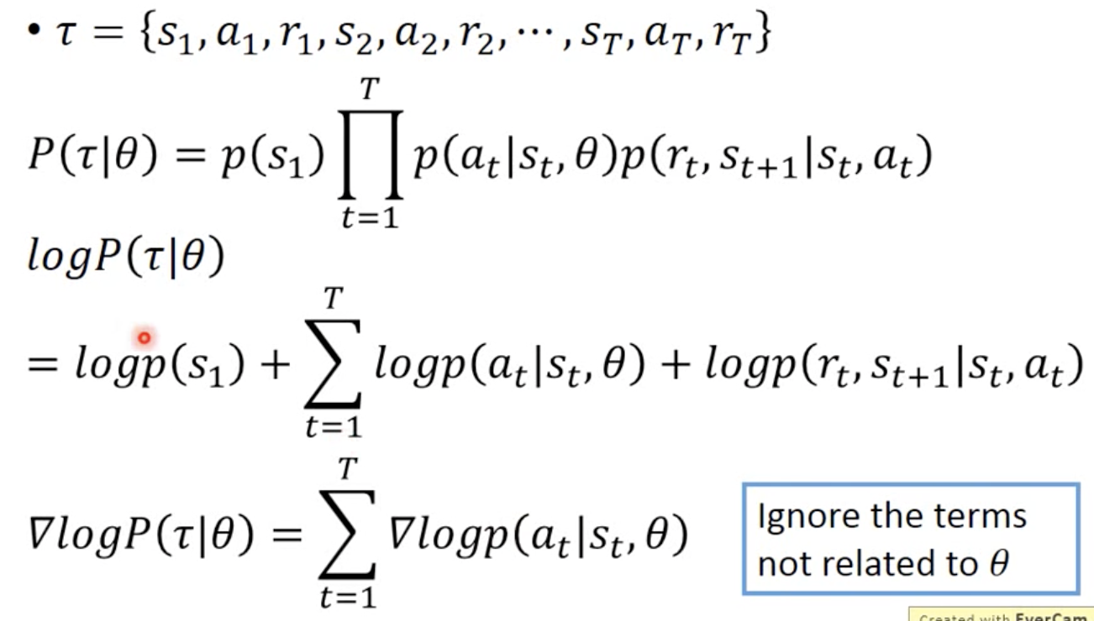
Policy Gradient
Step3：Pick the great function
Gradient Ascent
Part 1

Slide 8
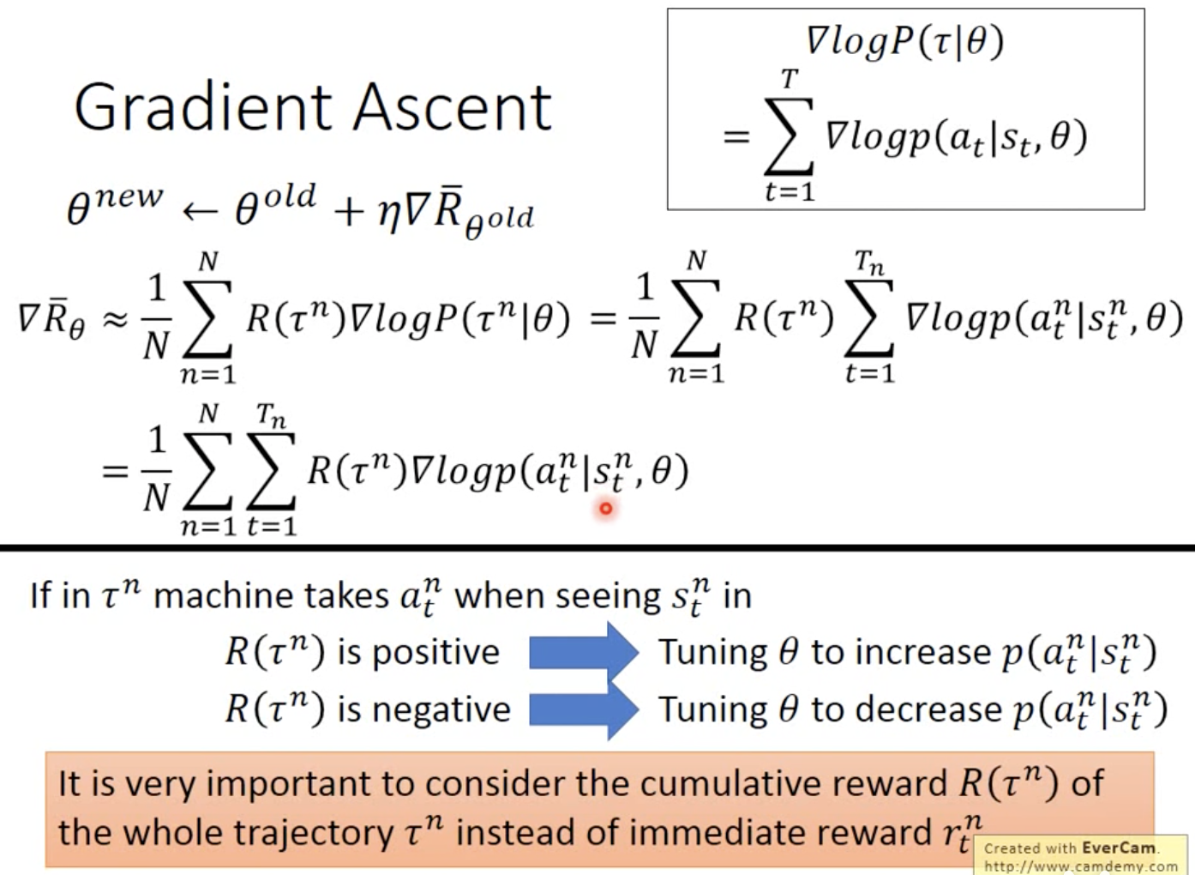
Step3：Pick the great function
Gradient Ascent
Part 2

Slide 9
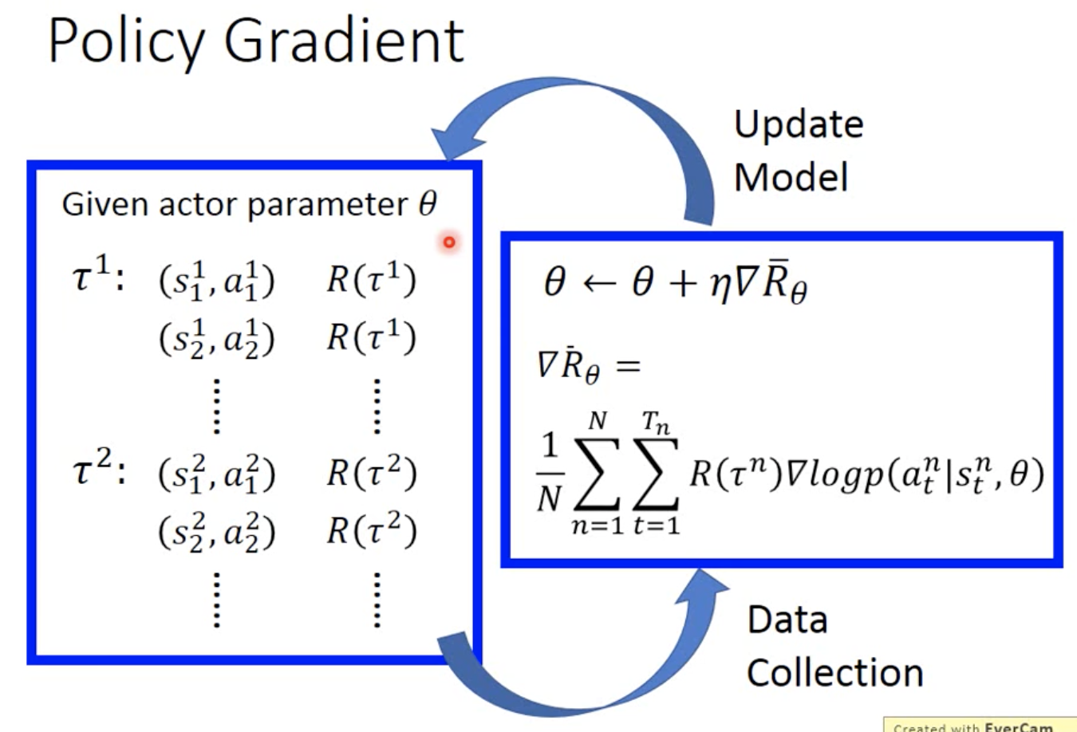

Slide 10
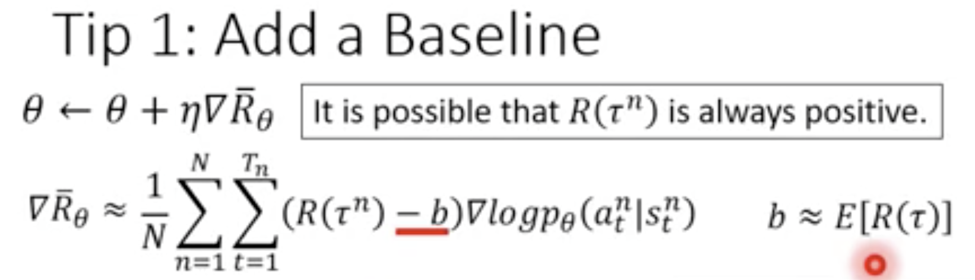
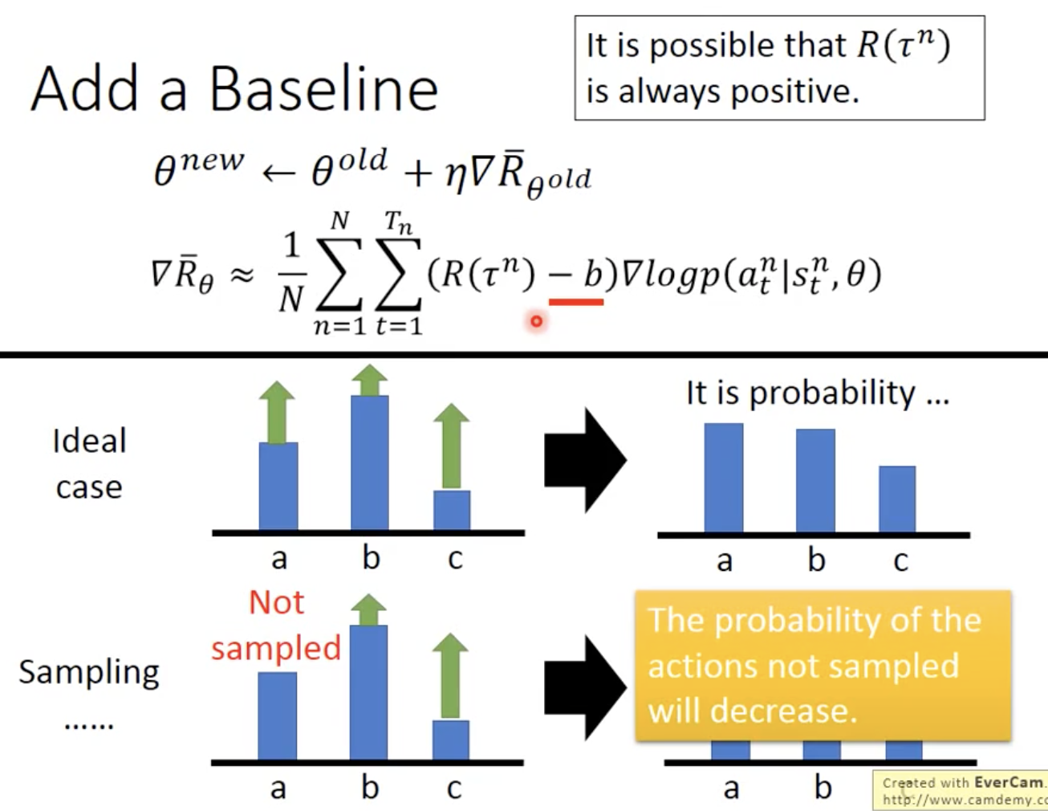
Policy Gradient
减去baseline 使得reward有正有负

Slide 11
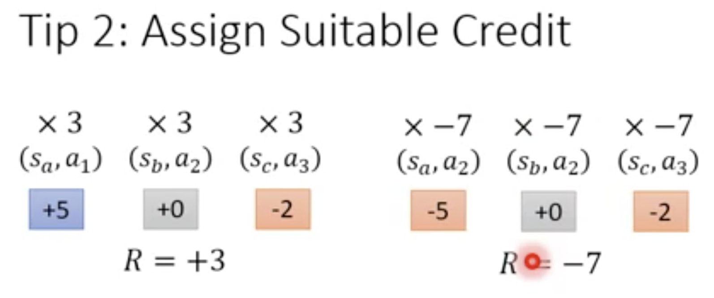
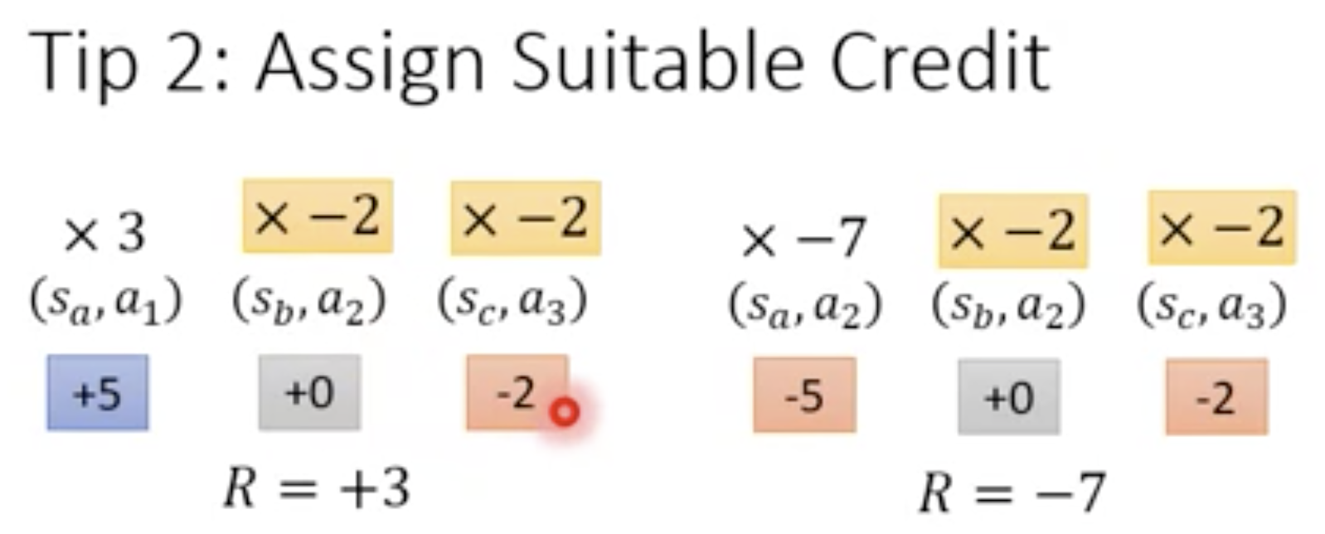
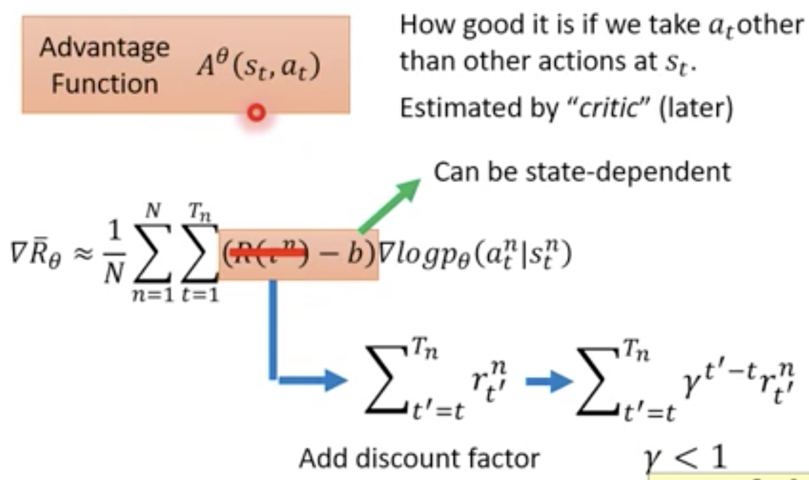
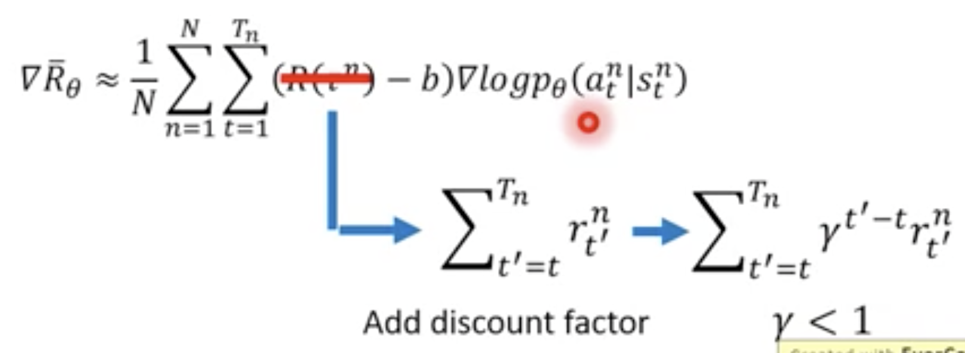
Policy Gradient

Slide 12
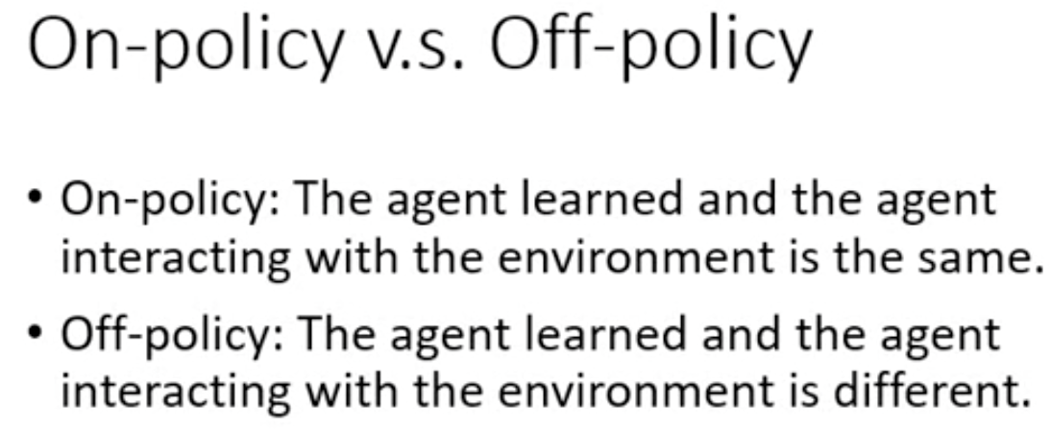
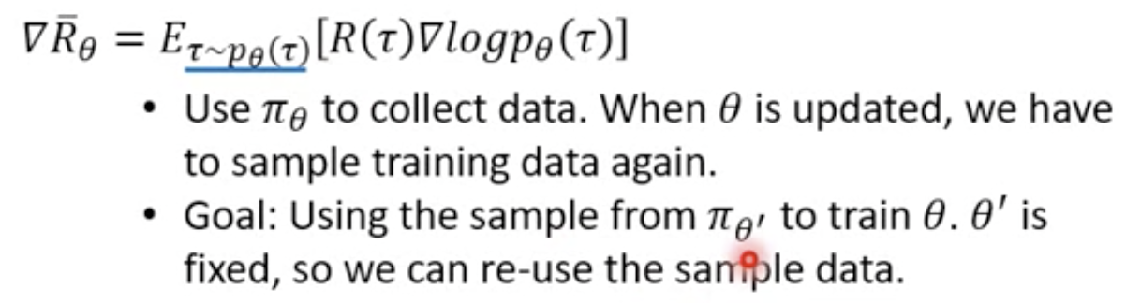
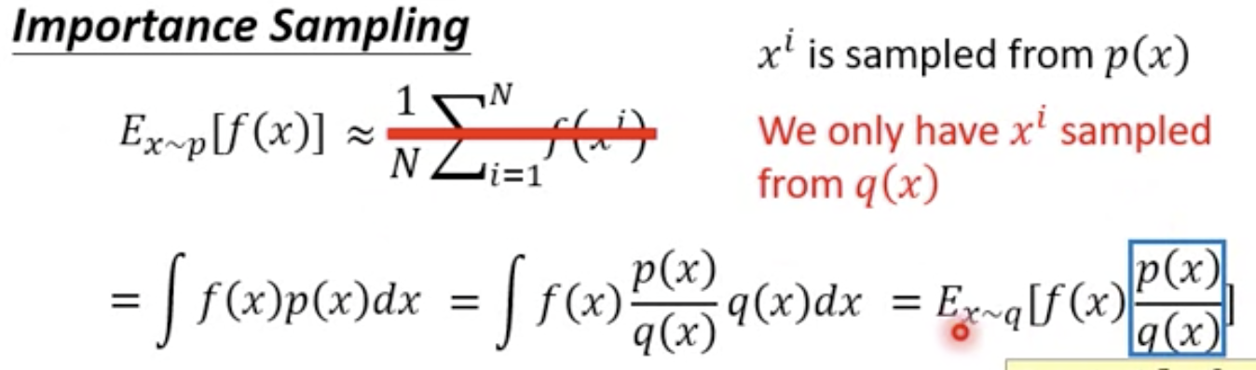
On-policy vs Off-policy
Policy gradient中要花很多时间进行采样
（因为更新一次策略参数之后之前的样本就
失效了，需要重新采样新的策略下的样本）
修正两个distribution之间的差异

Slide 13
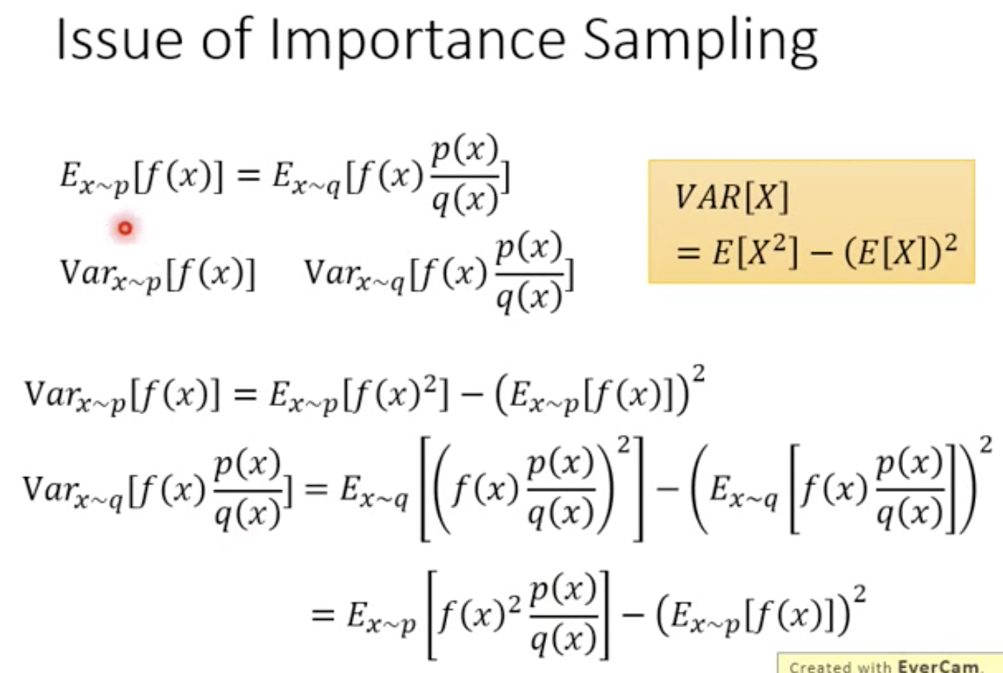
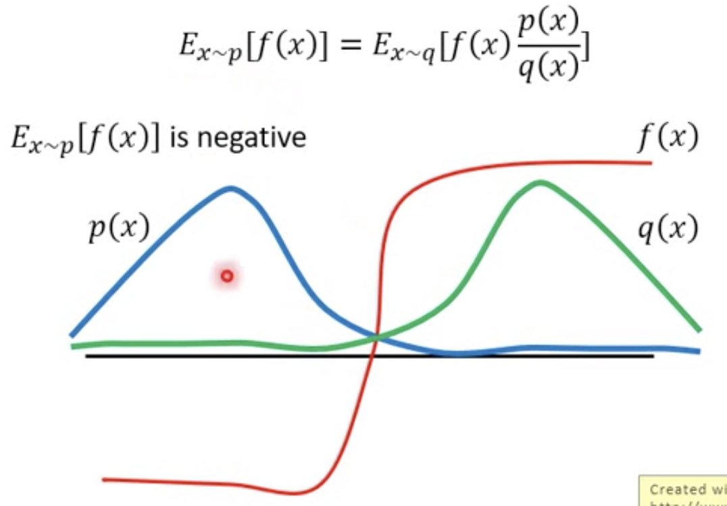
On-policy vs Off-policy
两个distribution之间的差异较大时，会有较大的方差

Slide 14
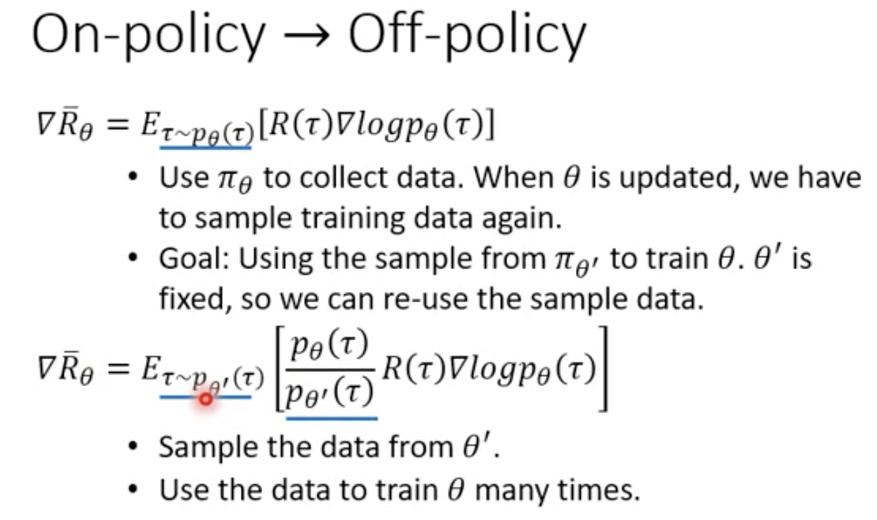
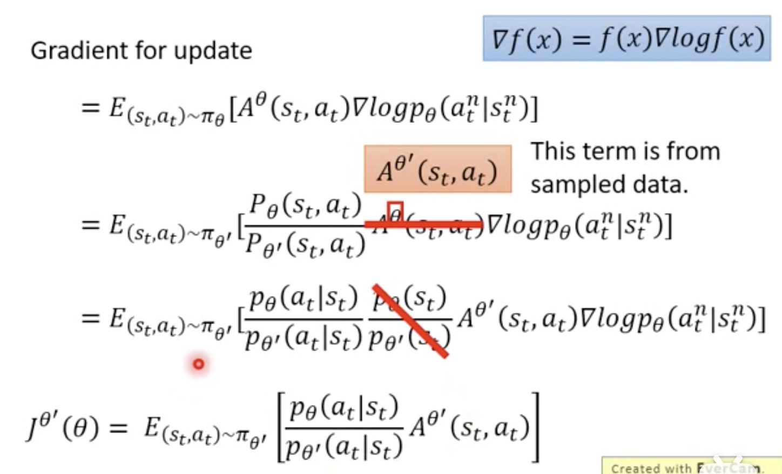
On-policy vs Off-policy

Slide 15
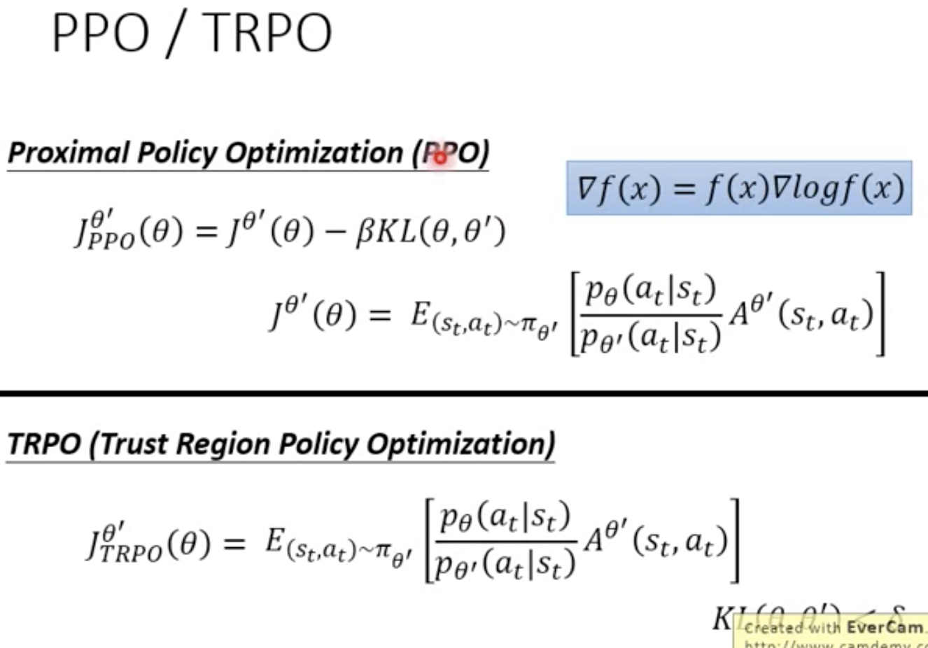
PPO / TRPO
为了避免两个分布差太多
需要增加constraint
衡量两个分布的相似度
计算action之间的距离
原理类似，但是PPO比TRPO应用起来更简单
KL是计算action的距离

Slide 16
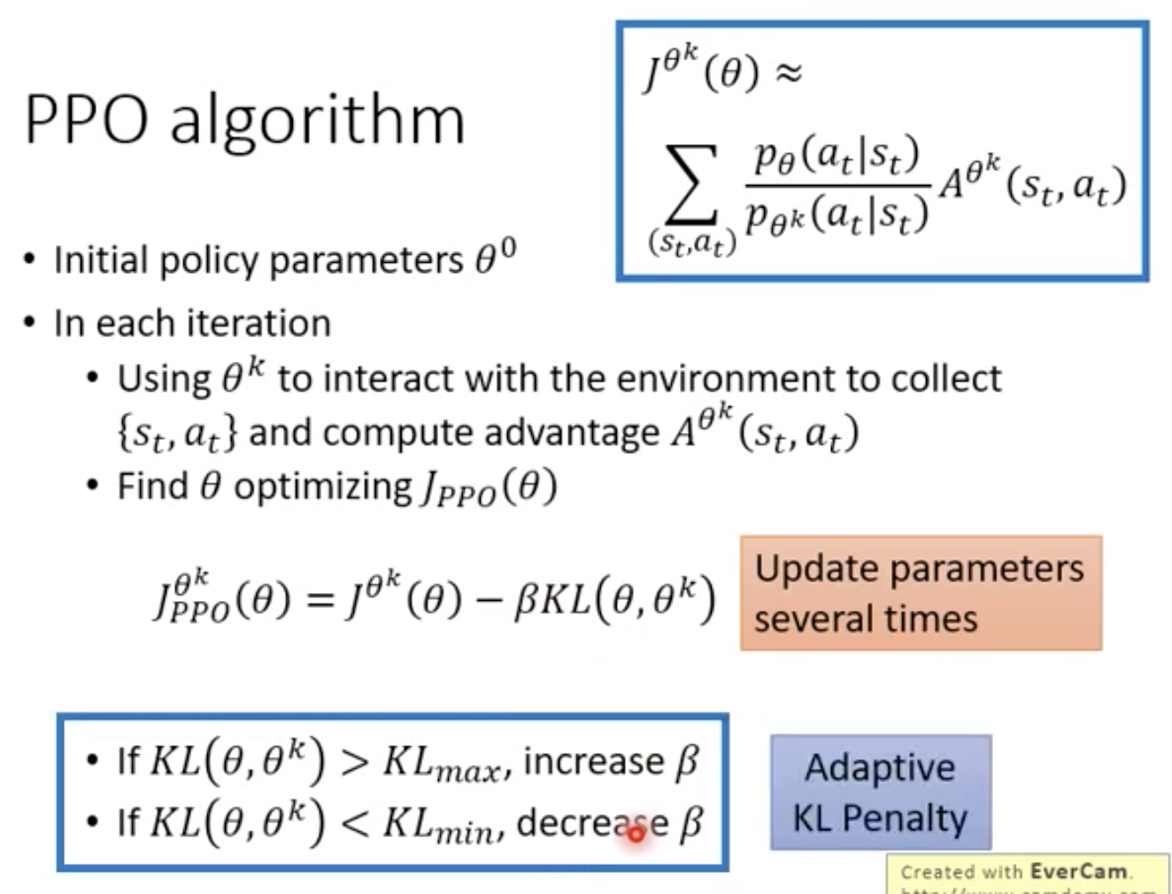
PPO
KL值太大 说明惩罚项不够

Slide 17
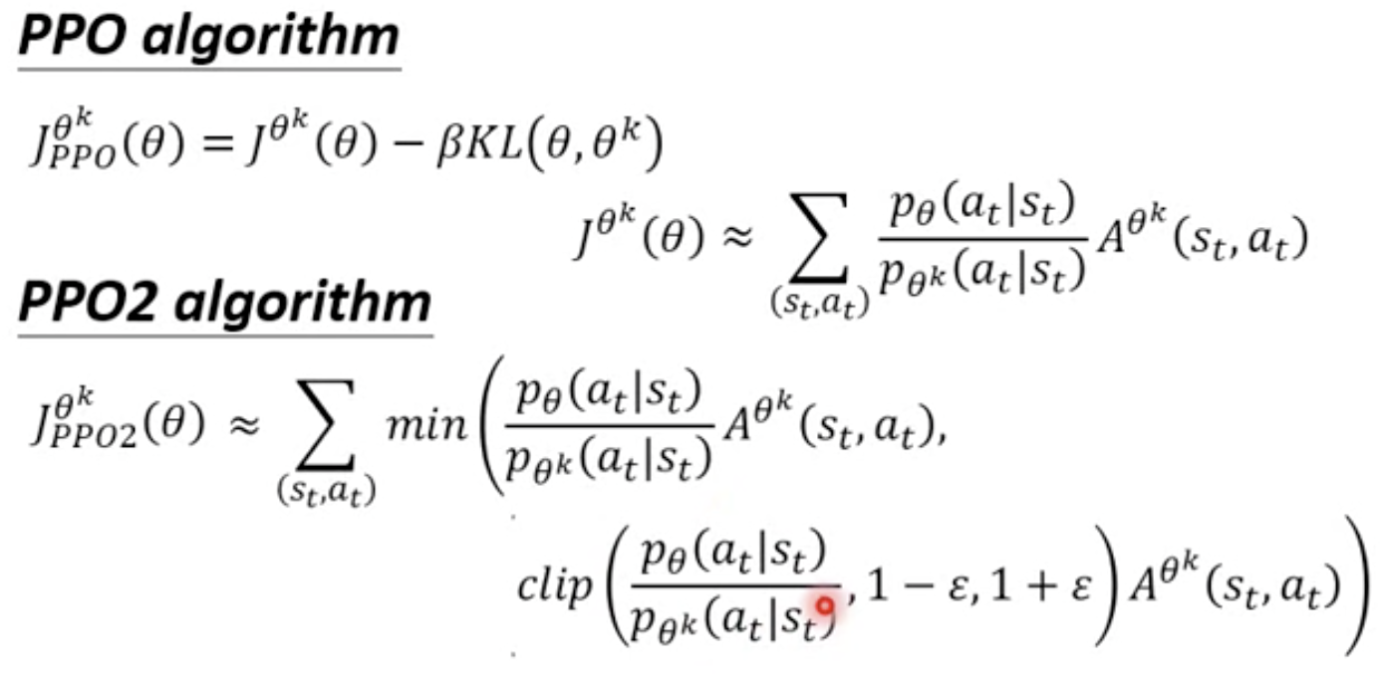
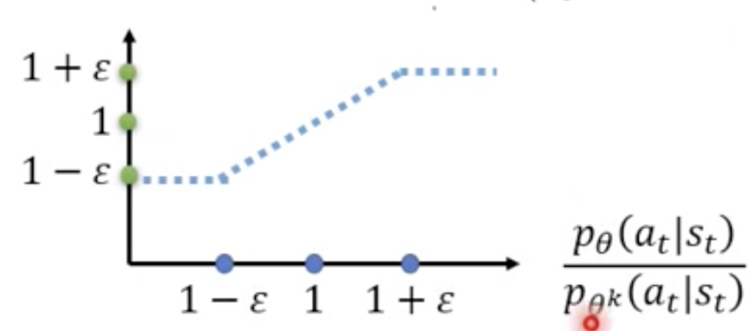
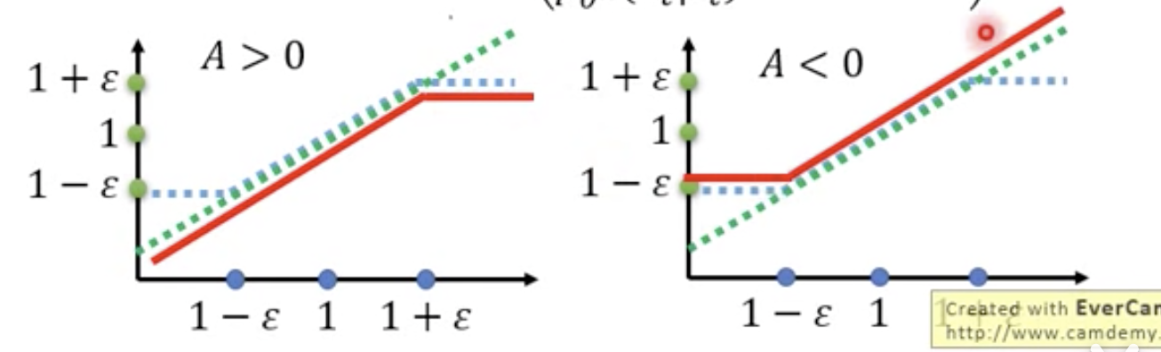
PPO / PPO2

Slide 18
Learning a Critic——Three kinds of Critics
Critic evaluates how good the actor is.

Slide 19
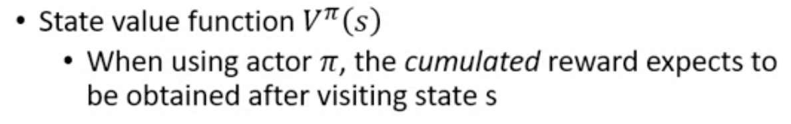
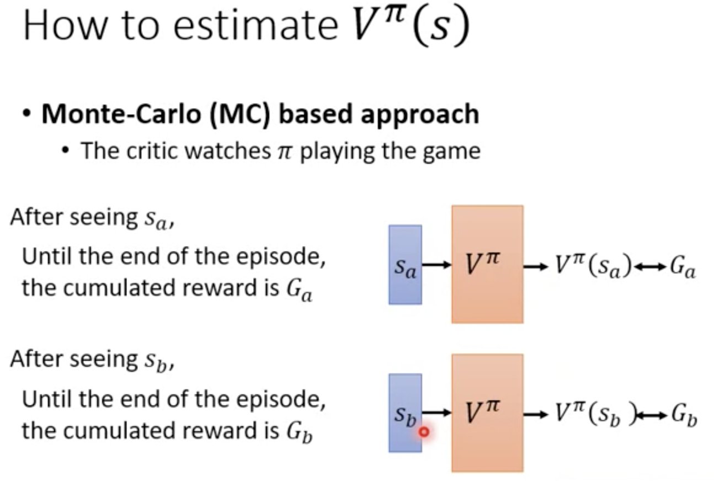
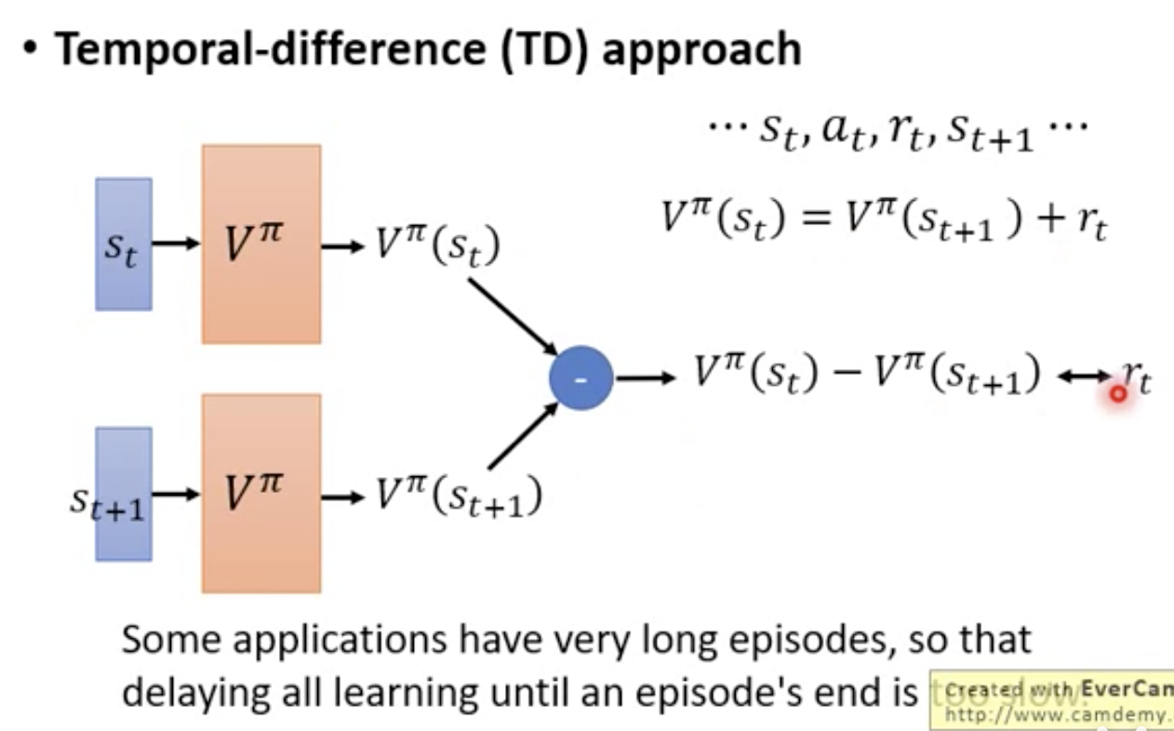
Critic——状态价值函数V

Slide 20
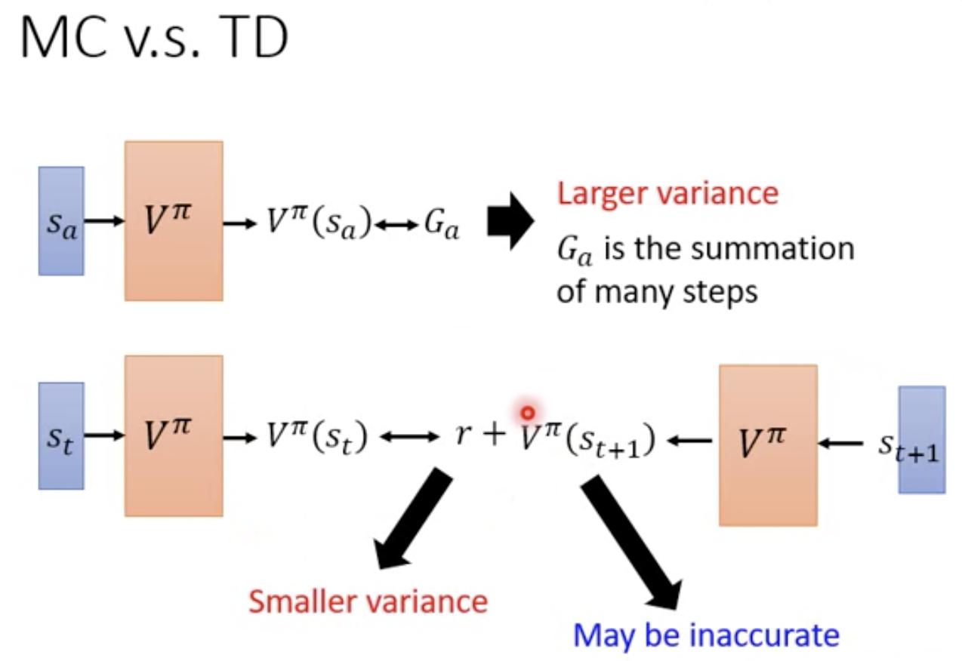
Critic——状态价值函数V

Slide 21
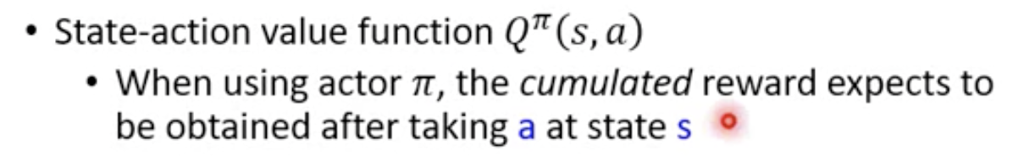
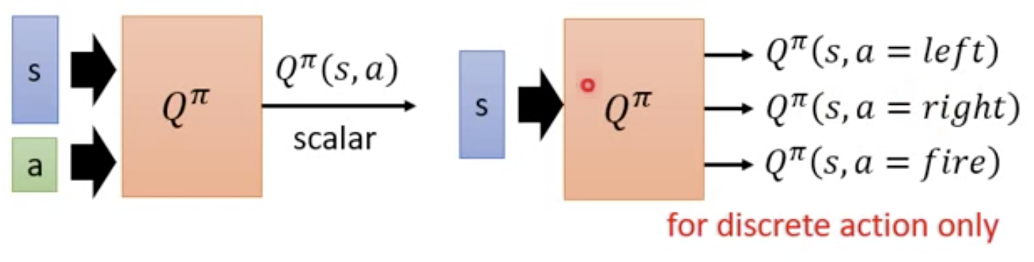
Critic——状态-动作价值函数Q

Slide 22
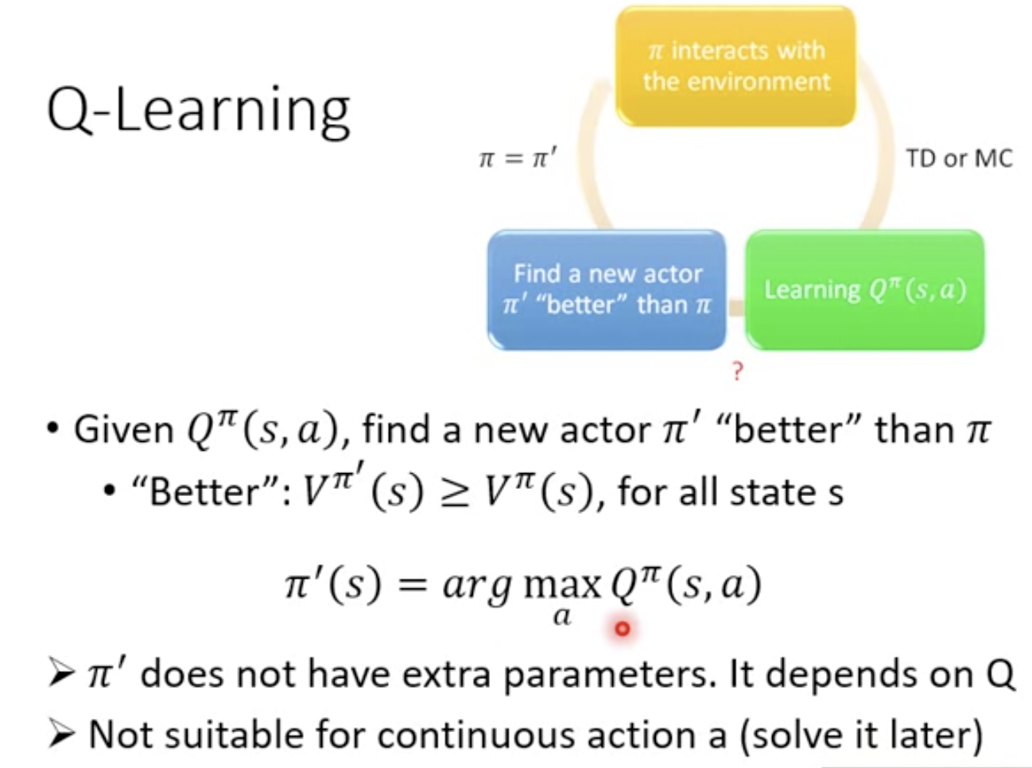
Critic——Q-Learning

Slide 23
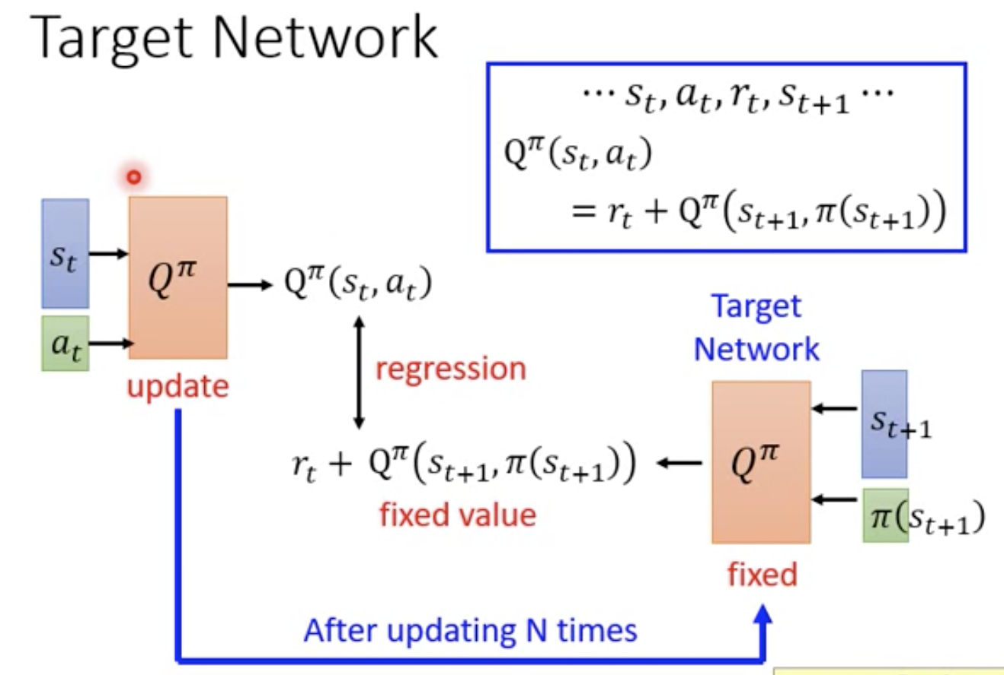
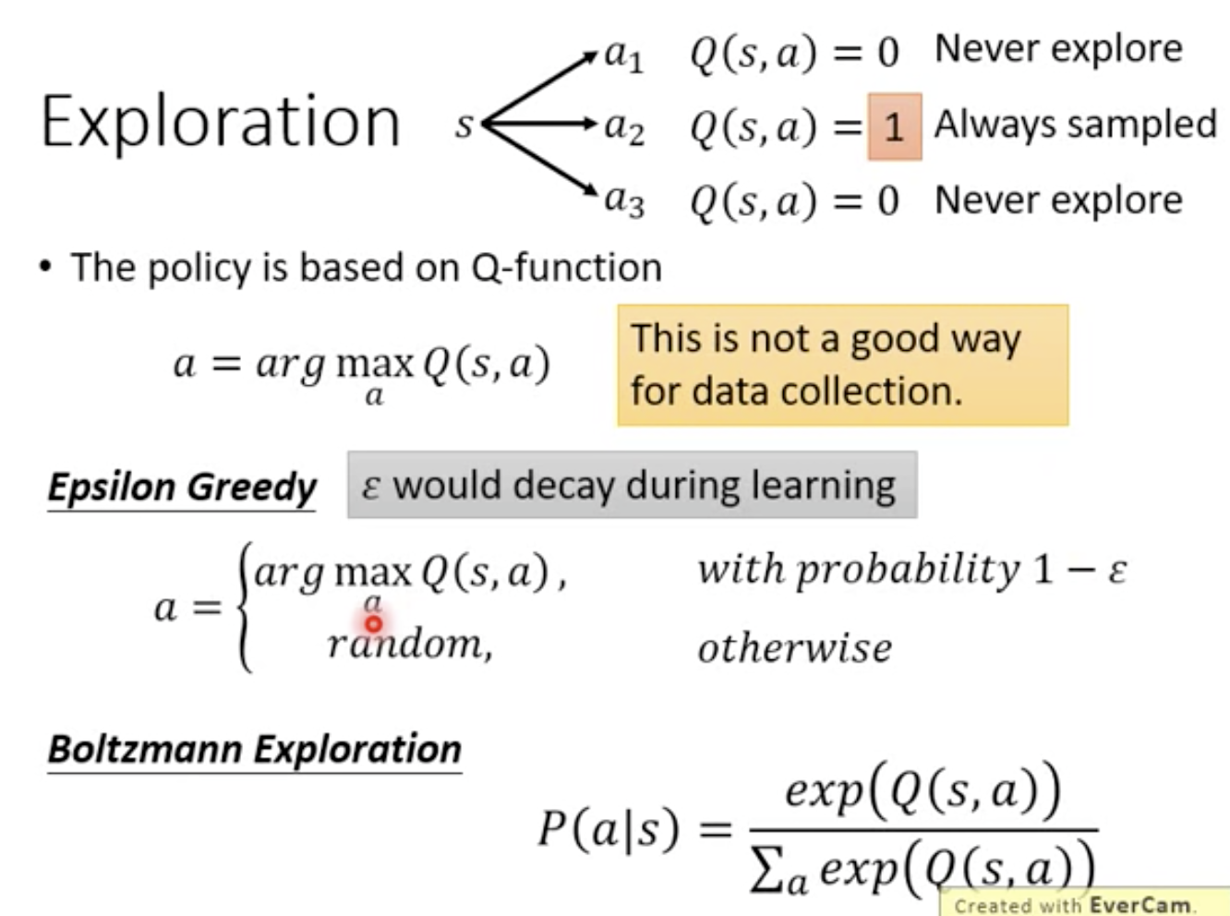
Critic——Q-Learning Tips

Slide 24
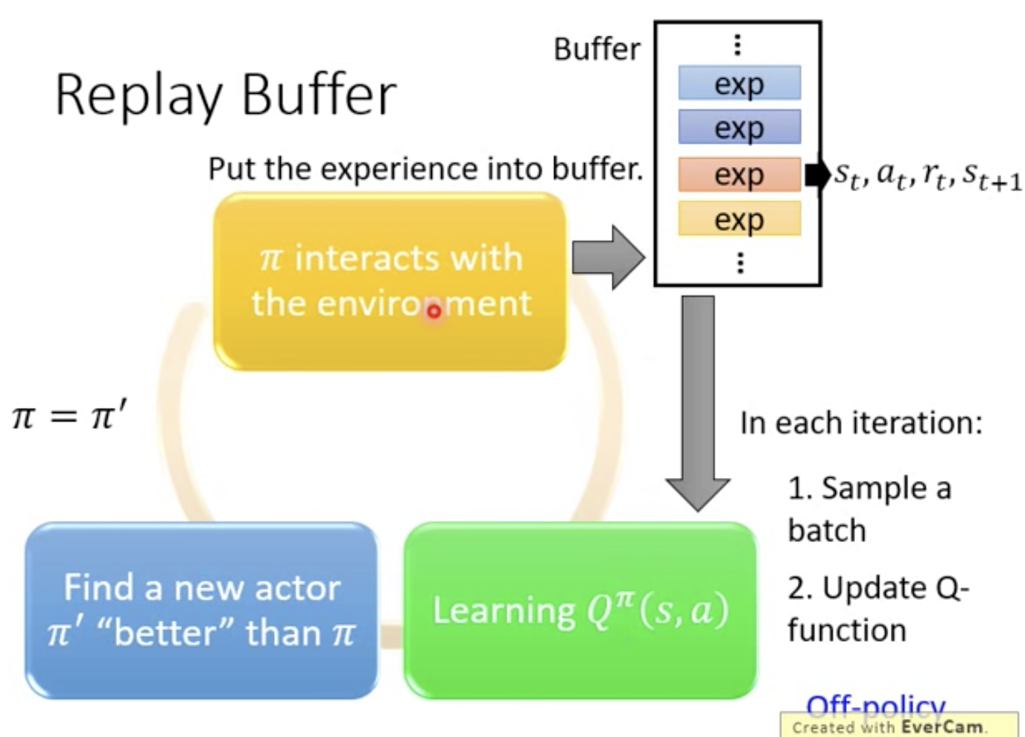
Critic——Q-Learning Tips

Slide 25
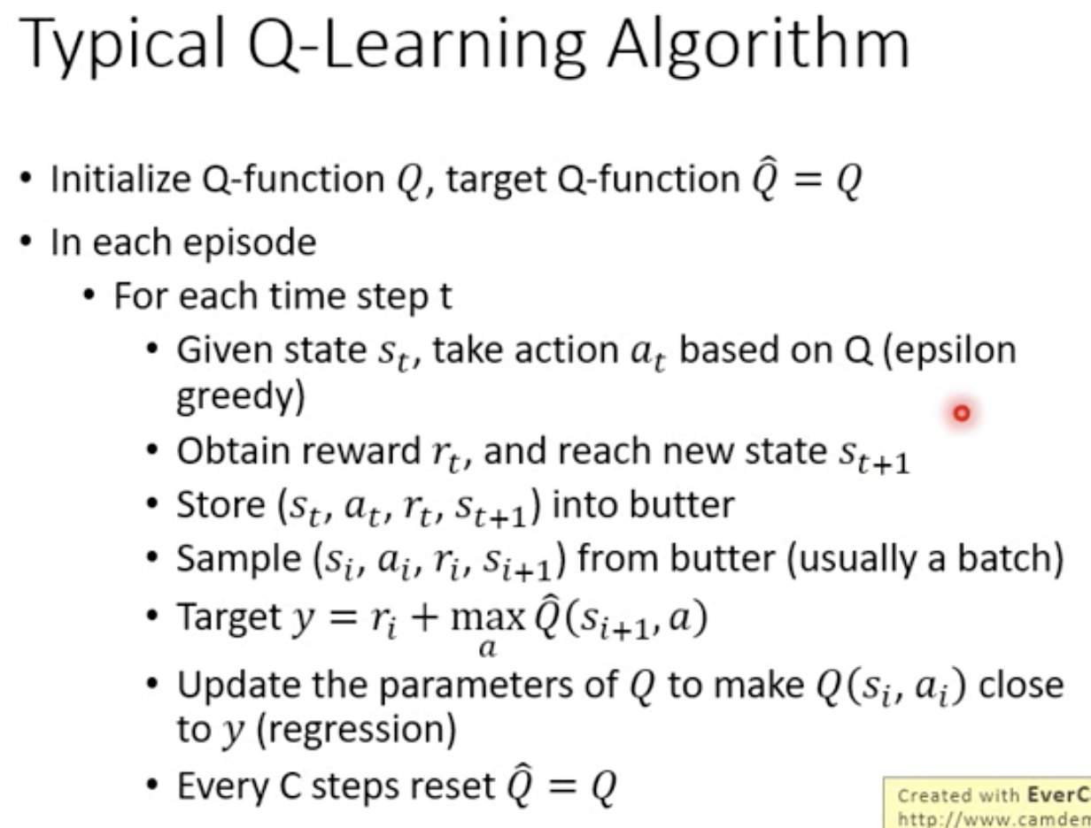
Critic——Typical Q-Learning Algorithm

Slide 26
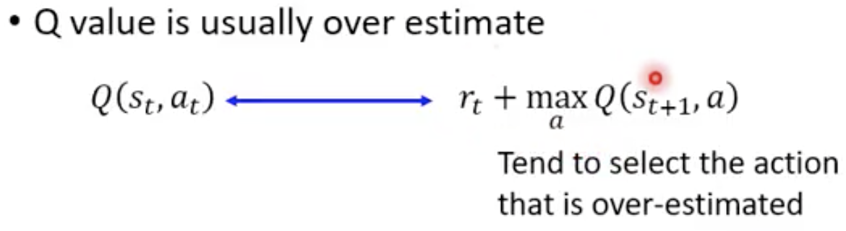
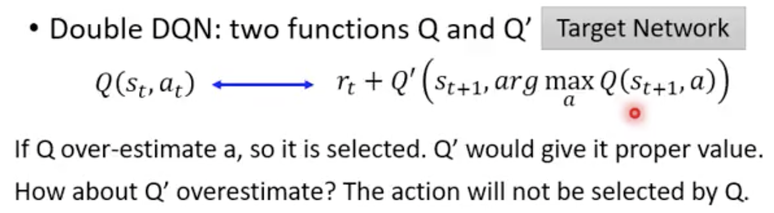
DQN Variants——Double DQN

Slide 27
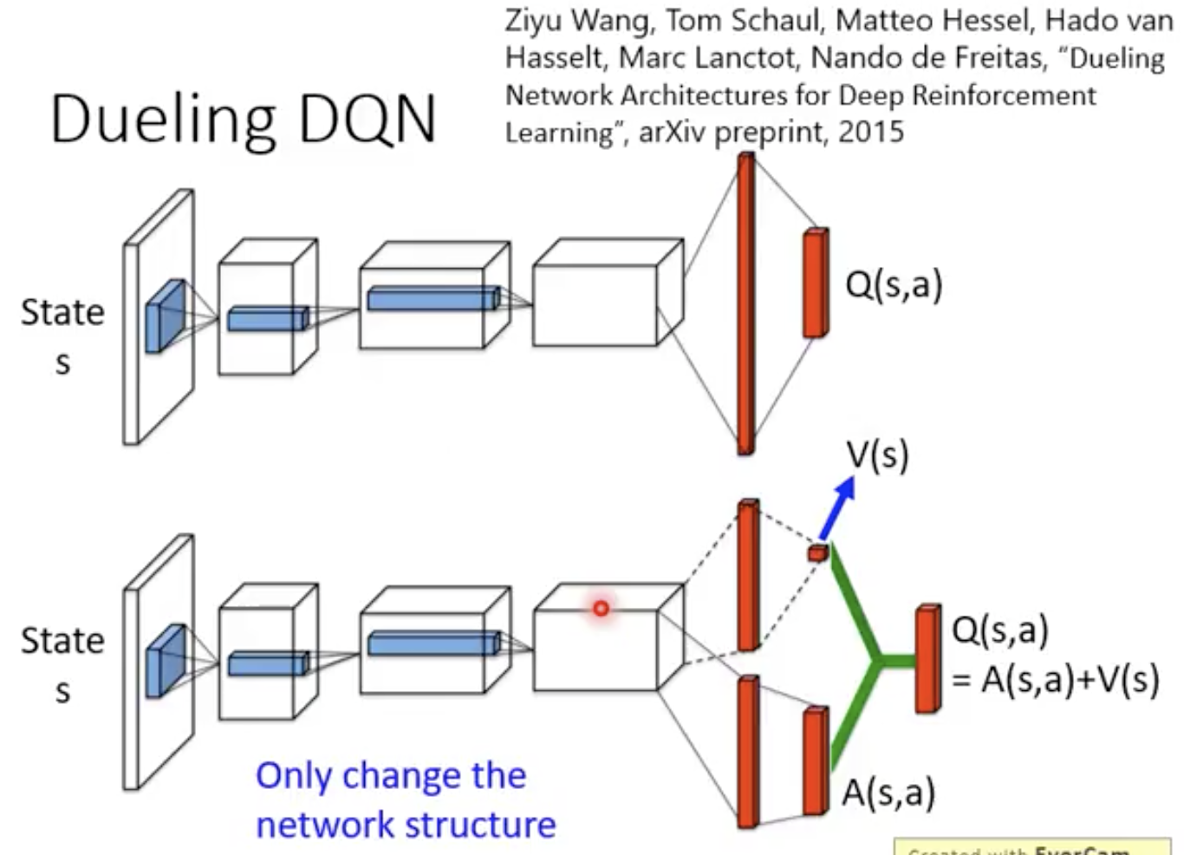
DQN Variants——Dueling DQN

Slide 28
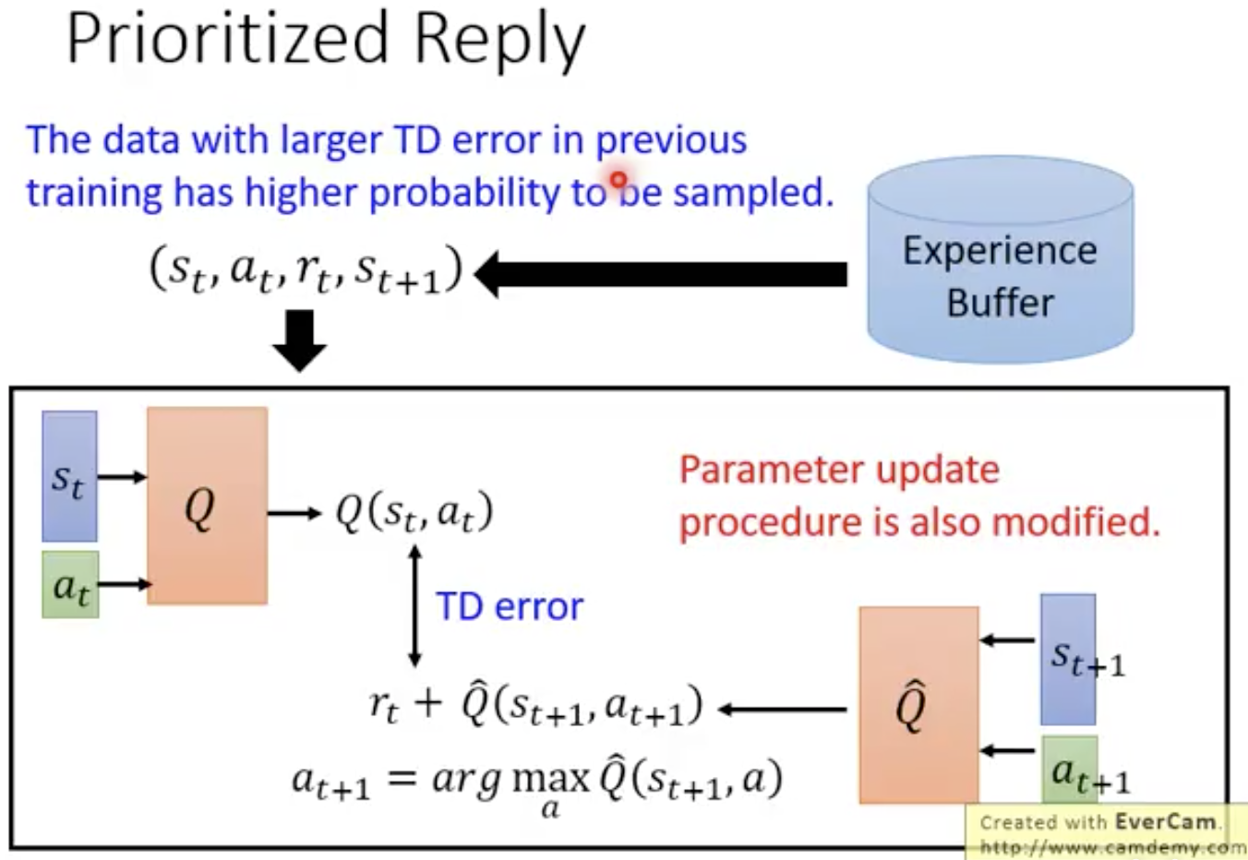
DQN Variants——DQN with Prioritized Replay

Slide 29
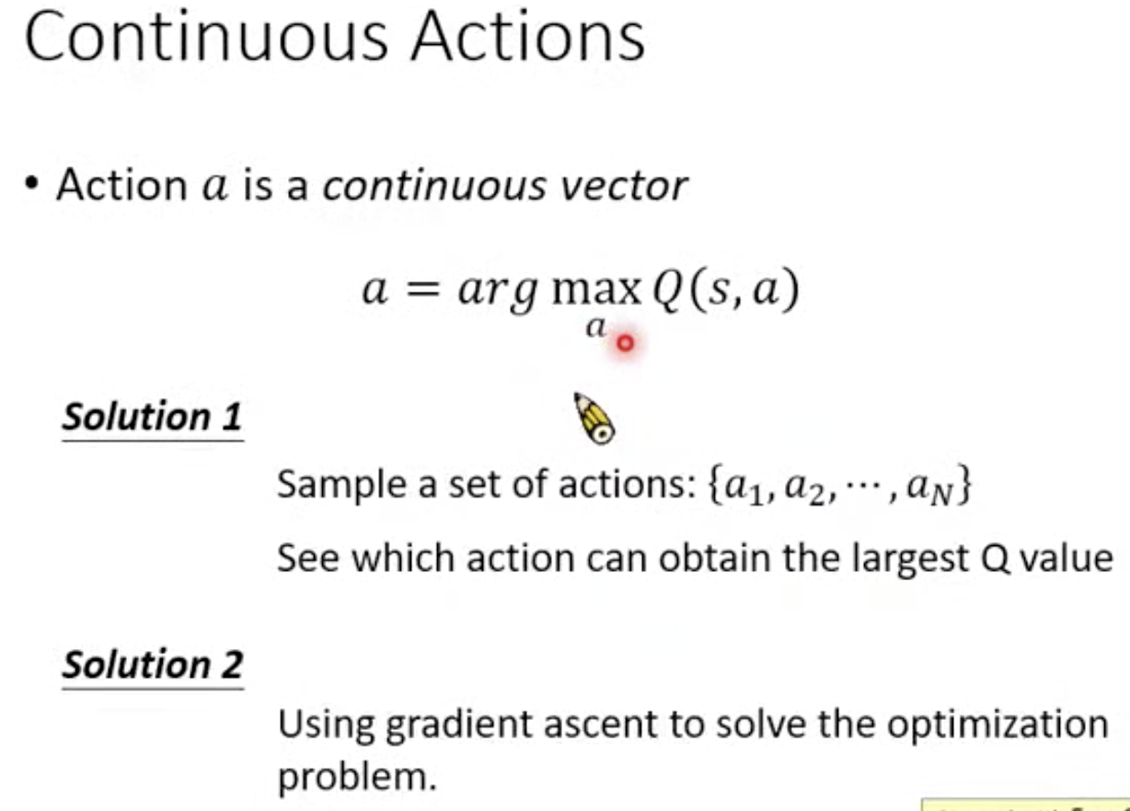
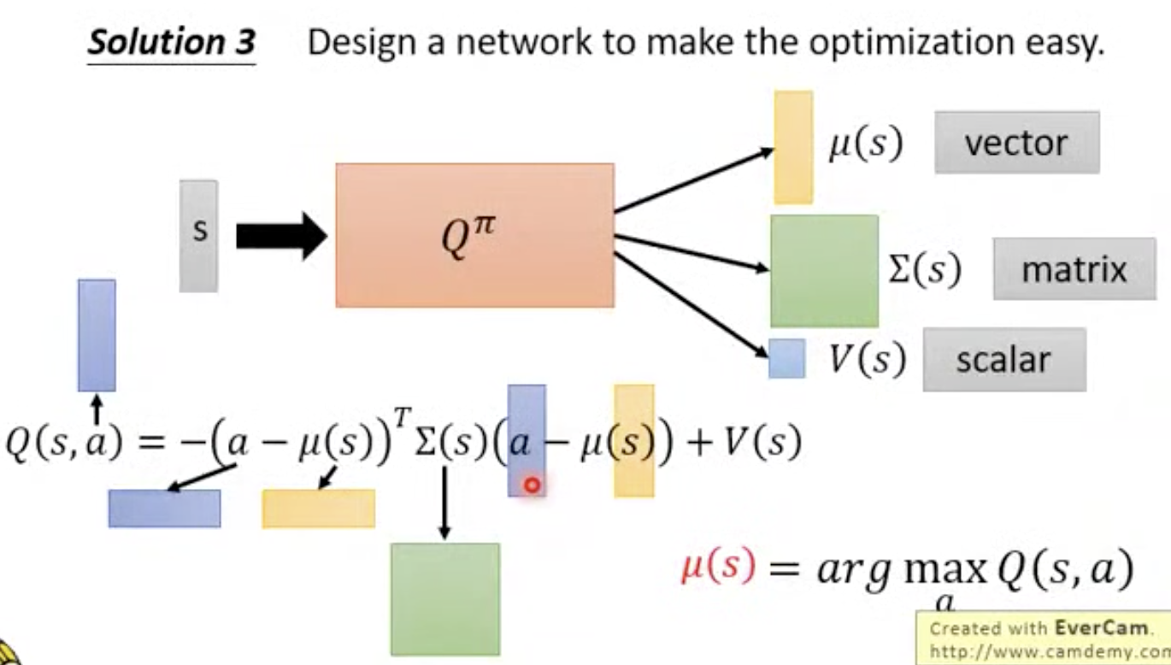
Q-Learning for Continuous Actions

Slide 30
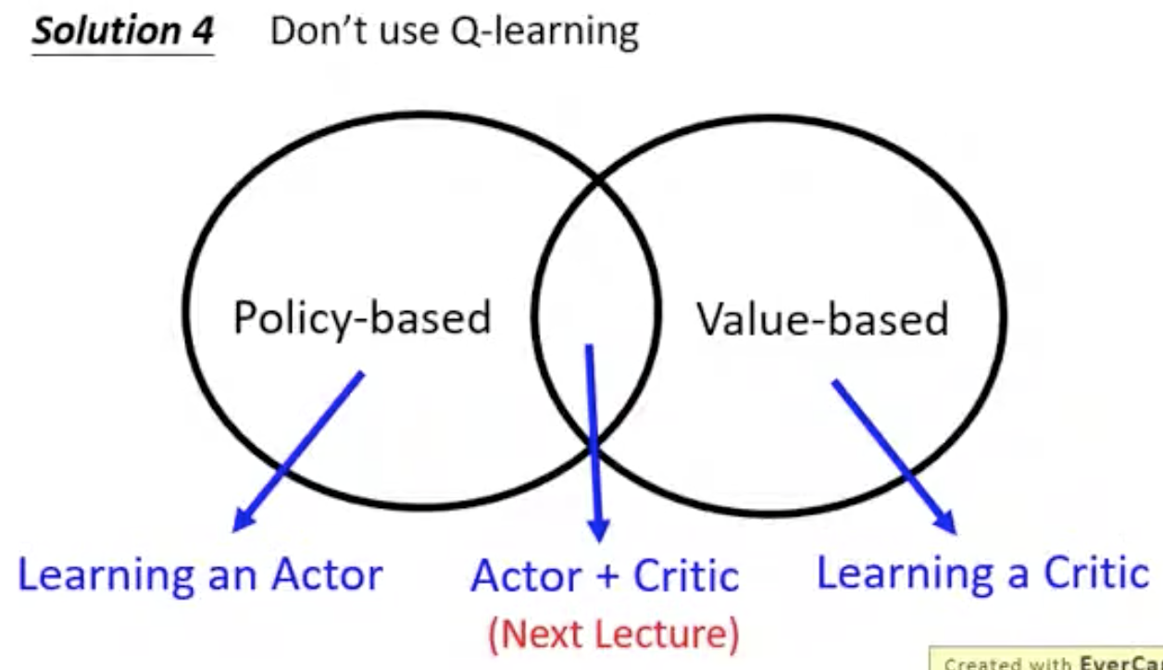
Q-Learning for Continuous Actions

Slide 31
Actor-Critic
A3C、A2C

Slide 32


Review of Actor and Critic
可能会有很大的方差

Slide 33


Actor-Critic

Slide 34


Actor-Critic
不同的action被采用的几率平均一些
在训练的时候会多尝试不同的action

Slide 35

Actor-Critic——A3C

Slide 36

Actor-Critic——Pathwise Derivative Policy Gradient

Slide 37
Sparse Reward Problem

